Slide 1
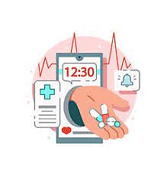
Personal Assistance For Seniors Who Are Self-Reliant
Team Leader : Harisha H
Team Members : Arthi K, Shivani M, Arthi K
Team ID : PNT2022TMID52309

Slide 2
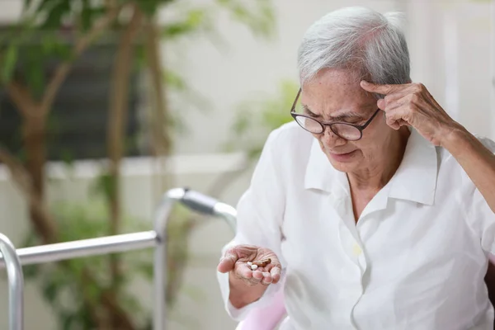
Problem Statement:
Some patients and also the caretakers forget to take/give the medicines at the right time. And it is difficult to memory the medicine names. Some people find it difficult to learn new apps in this ever-expanding digital environment,and people nowadays tend to forget things more easily, such as taking their prescriptions. People need a way to remember to take their prescriptions without having to learn how to use sophisticated programs.

Slide 3
Literature Survey
S.No | Title | Author | Advantage | Disadvantages
1 | Ardumed-Smart Medicine Reminder Old people | MaureshWavkole,VatsalvaPrakash,Himansu Singh,Nalini | It can be easily understood by the user | They don’t facilitate storing the original prescription
2 | Medication Reminder System | MohamedAbdullah,Shahd-At Hatem,Athraa Leekha | User friendly and accurate measuring for the time | Many hardware components are used so device cost is high
3 | Voice based Medicine Reminder Alert application for old people | Mehala , Dr.J. Viji Gripsy | This application have both safety and security | Existing system can be eradicated by using mobile application

Slide 4
Information Gathering:
To get started with the project , we have analyzed various journals and got the information which will leads to the best solution.
*Exsisting medicine reminder systems have some disadvantages like high cost,innacurate and so on.
*For the effective reminder people are expecting some new features.
*Voice commands are more interested than text command.

Slide 5
Solution:
* An app is build for the user (caretaker) which enables him to set the desired time and medicine .These details will be stored in the IBM cloudant DB.
* If the medicine time arrives the web application will send the medicine name to the IoT Device through the IBM IoT platform.
* The device will receive the medicine name any notify the user with voice commands.

Slide 6
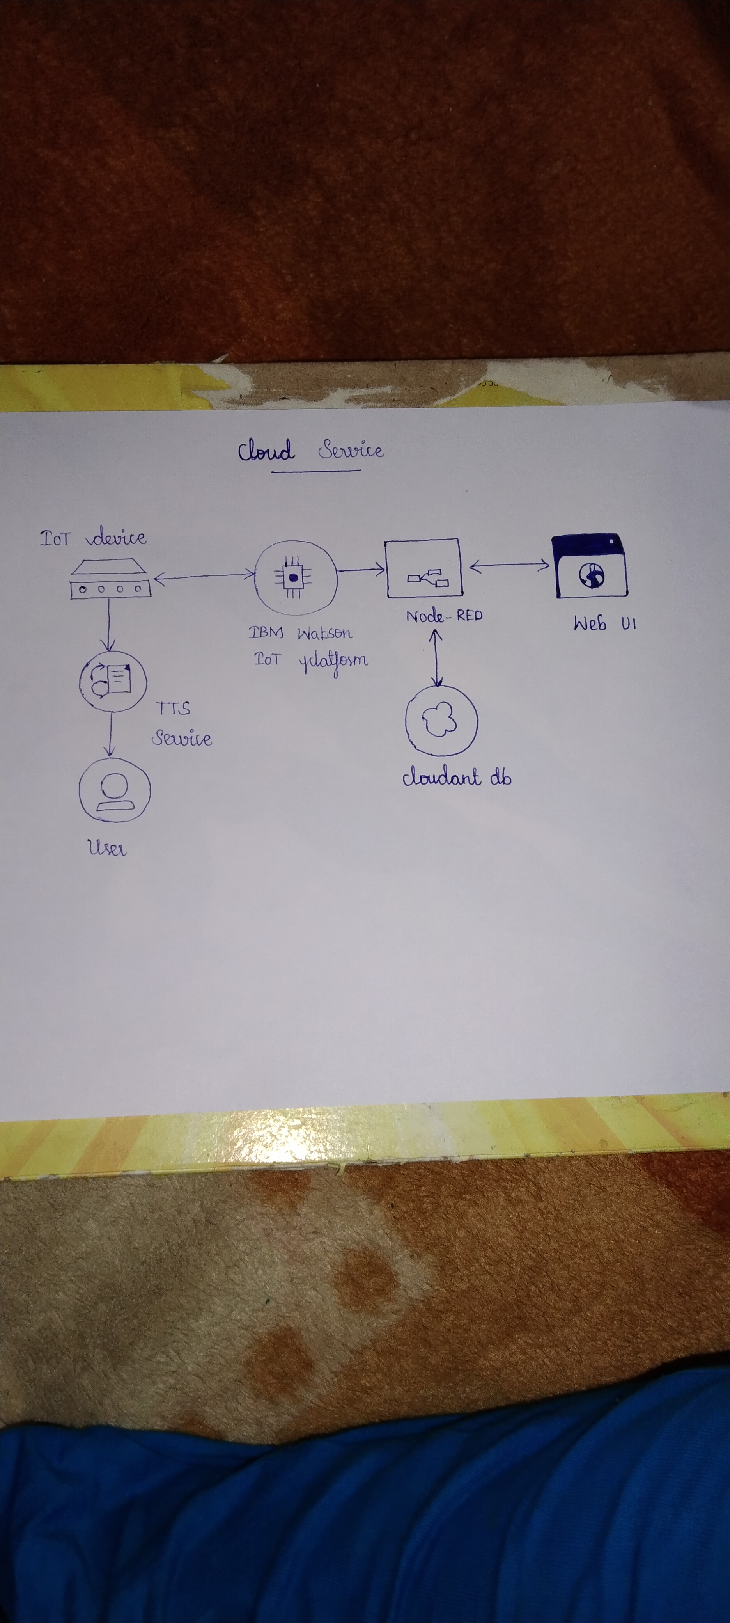
Block diagram:

